Slide 1
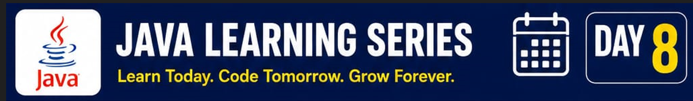
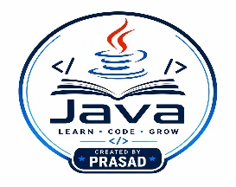
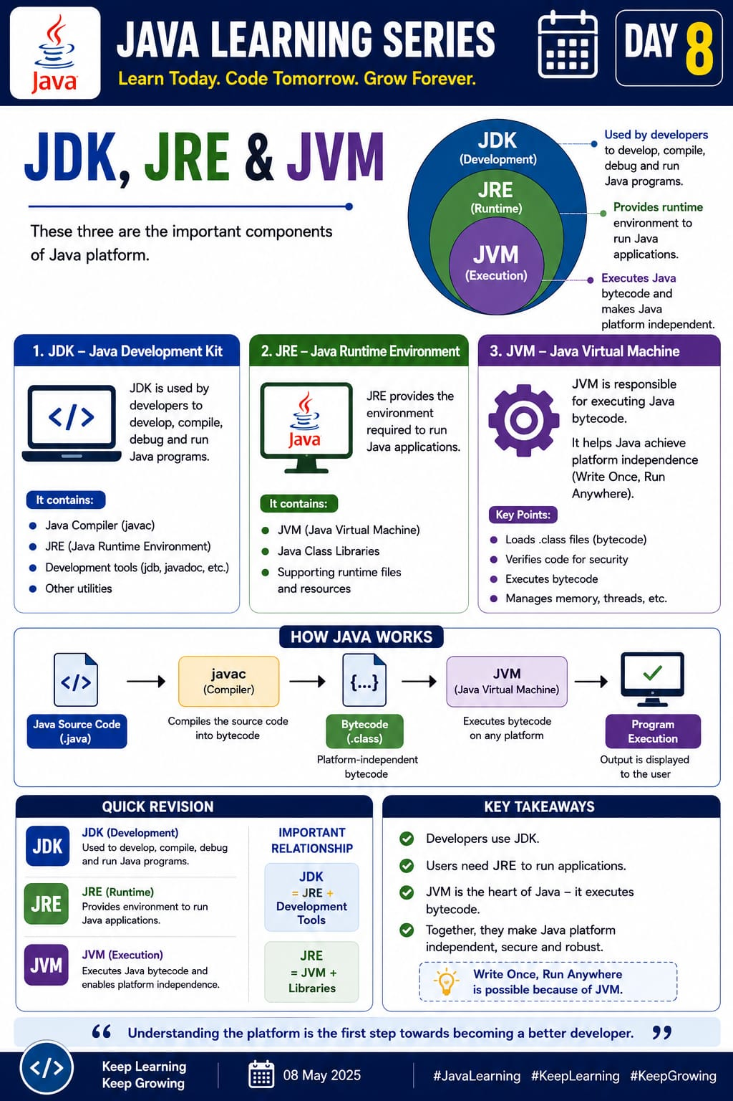

1. ☕ JDK – The Toolbox
Think of it like a carpenter's full toolbox.
It has everything you need to write code, build it, and debug it.
👉 Only developers need this.
2. ☕ JRE – The Ready Kitchen
Like a kitchen that's already set up to serve food that's been cooked.
It's not for writing code — it just gives you the environment needed to run an app.
👉 This is all app users need.
3. ☕ JVM – The Engine
Like the engine inside a car.
It takes the bytecode and actually executes it — on any operating system.
👉 This is what makes "Write Once, Run Anywhere" possible.

